Slide 1
Explainable Machine Learning with Shapley Values
Notes:
Hello everyone, today I will be presenting the group project that I yashaswini along with my teammate nishith ramanuj have worked on for the course “algorithmic game theory”. The topic we have chosen is “Explainable Machine Learning with Shapley Values”

Slide 2
Background
Notes:
Let us start with some background, which will involve some of the important concepts that we came across while doing our project and will be needed in order to explain our work.

Slide 3
1.
Cooperative Game Theory and Shapley values
A brief introduction to these concepts

Slide 4
Cooperative Game Theory
Deals with coalitions which coordinate their actions and pool their winnings
Mathematical Setup
A cooperative n person game in coalition form is an ordered pair <N, v> where
N = {1, 2, ……., n} and v : 2ⁿ → ℝ is a map assigning to each coalition S ε 2ⁿ a real number such that v(Ø) = 0.
v is the characteristic function of the game
v(S) is the worth or value of the coalition S
Notes:
a cooperative game (or coalitional game) is a game with competition between groups of players ("coalitions") due to the either external enforcement of cooperative behavior (e.g. through contract law) or due to greater benefit to players upon forming coalitions. These are different from non-cooperative games which we have been studying throughout the course in which there is either no possibility to forge alliances or all agreements need to be self enforcing.
Talk about mathematical setup on slide

Slide 5
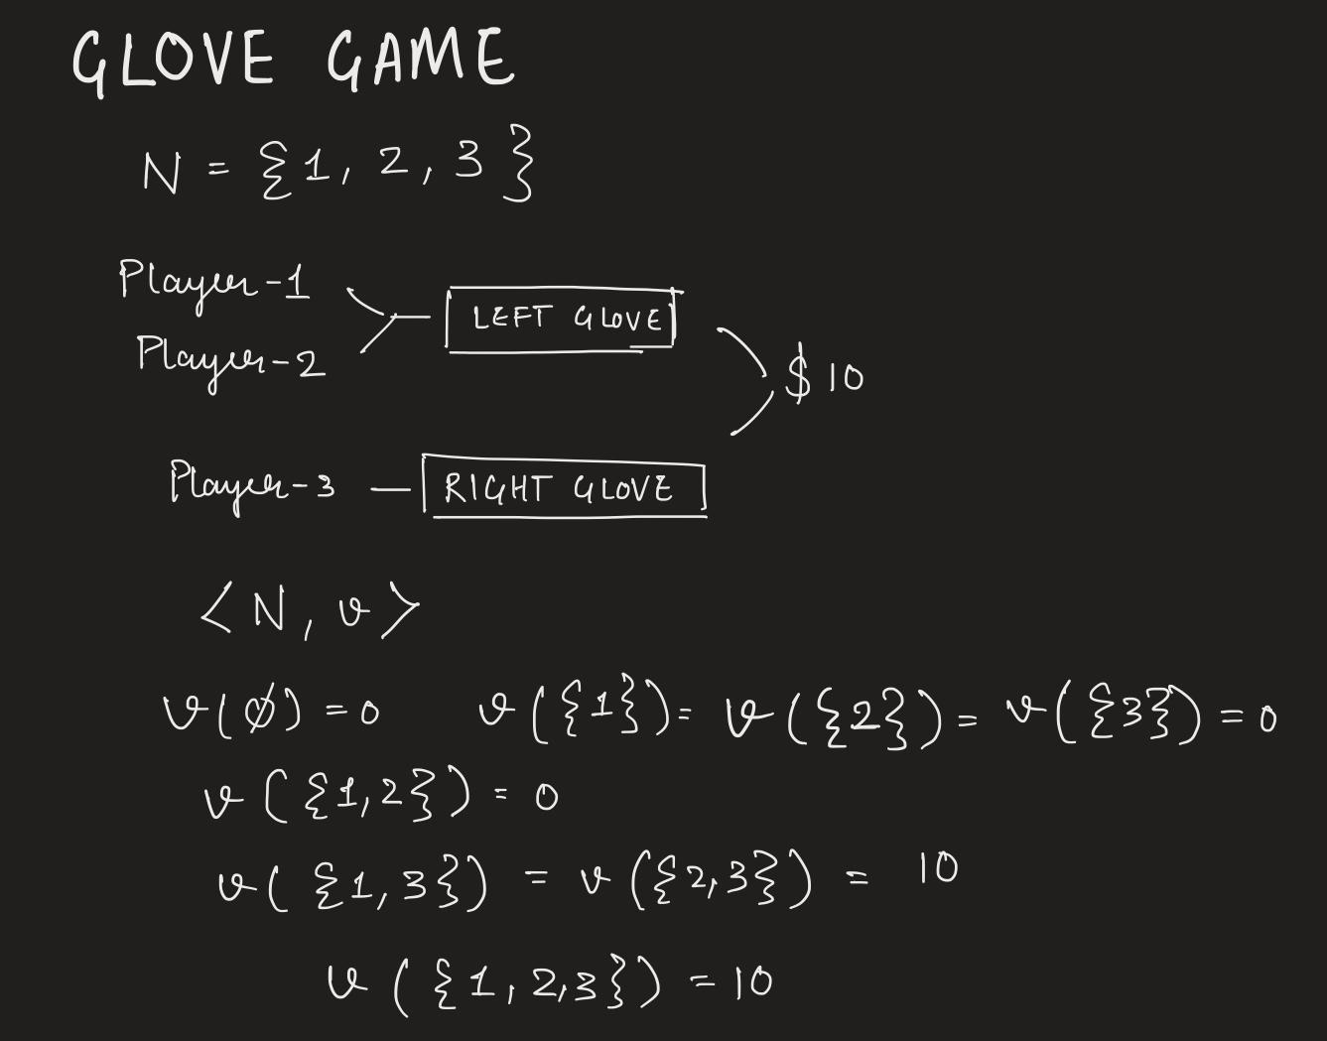
Example

Slide 6
Shapley Values
Solution concept in cooperative game theory that provides unique allocation to a set of players in a coalition game.
Mathematical Setup
Given a coalition form game <N, v> we denote the shapley value as Ø(N, v)
Ø(N, v) = (Ø₁(N, v), Ø₂(N, v), ….. Øₙ(N, v)) where Øᵢ(N, v) is the expected payoff to player i
Notes:
The Shapley value is a concept in game theory used to determine contribution of each player in a coalition or a cooperative game. Assume teamwork is needed to finish a project. The team, T, has n members. Knowing that the contribution of team members during the work was not the same, how can we distribute the total value achieved through this teamwork, v=v(T), among team members? Shapley value, φi(N, v), is the fair share or payout to be given to each team member i.

Slide 7
Axioms
Symmetry
Given any permutation 𝝅 on N, and any player i, the symmetry axiom states
𝜱𝝅(i)(𝝅v) = 𝜱ᵢ(v)
Linearity
Given two coalition games <N, v> and <N, w>. Suppose p ⋲ [0, 1] then for the new coalition game <N, pv +(1-p)w> can be defined such that
𝜱ᵢ(pv +(1-p)w) = p𝜱ᵢ(v) + (1-p)𝜱ᵢ(w)
Carrier
A coalition D is said to be carrier of a coalition game <N, v> if v(C⋂D) = v(C_.
If D is a carrier and i ∉ D then
Σ𝜱ᵢ(v) = v(D) = v(N)
Notes:
Symmetry
Shapley value of a player relabeled by a permutation, under the permuted value function is the same as the Shapley value of the original player under the original value. This axiom implies that only the role of a player in the game should matter. The labels or specific names used in N are irrelevant.
Linearity
the Shapley value of a player for a convex combination of coalitional games is the convex combination of Shapley values of the player in the individual games.
Carrier
This axiom asserts that the players in a carrier set should divide their joint worth (which is equal to the worth of the grand coalition) among themselves.

Slide 8
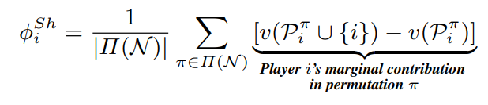
Calculation of Shapley Value
Given a coalition game <N, v>

Slide 9
2.
SHAP
(Shapley Additive exPlanations)
Approximation of Shapley value to explain ML models

Slide 10
Explaining Machine Learning Models as a Game
The “game” is reproducing the outcome of the model,
The “players” are the features included in the model.
SHAP quantifies the contribution that each feature brings to the prediction made by the model.

Slide 11
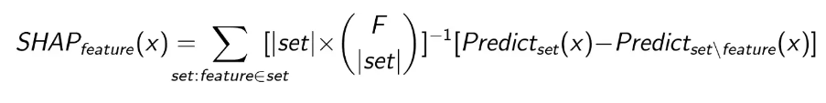
Calculating SHAP values

Slide 12
3.
Machine Learning Models:
Logistic Regression
Random Forest
A brief summary of the working of these models

Slide 13
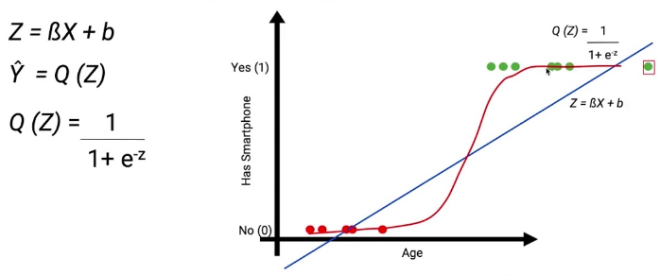
Logistic Regression

Slide 14
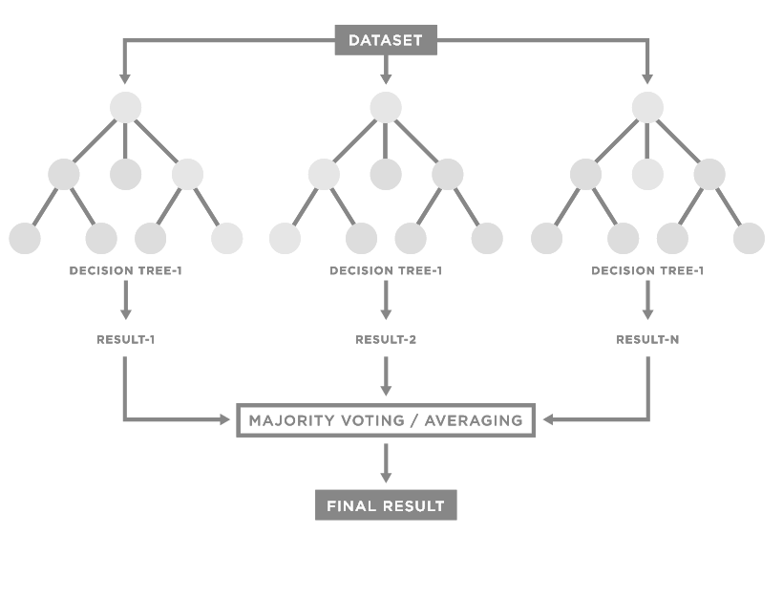
Random Forest

Slide 15
Project

Slide 16
Problem Statement
We explain the prediction of two machine learning models - Logistic Regression and Random Forest using SHAP (Shapley Additive exPlanations) on a modified version of the Breast Cancer Wisconsin Dataset

Slide 17
About the Dataset:
Breast Cancer Wisconsin
Features are computed from a digitized image of a fine needle aspirate (FNA) of a breast mass. They describe characteristics of the cell nuclei present in the image.
Ten real-valued features are computed for each cell nucleus: a) radius (mean of distances from center to points on the perimeter), b) texture (standard deviation of gray-scale values), c) perimeter, d) area, e) smoothness (local variation in radius lengths), f) compactness (perimeter^2 / area - 1.0), g) concavity (severity of concave portions of the contour), h) concave points (number of concave portions of the contour), i) symmetry, j) fractal dimension ("coastline approximation" - 1) to predict whether tumor is Malignant or Benign.
Mean, Worst and Standard deviation calculated for each, so, there are total 30 features.
In our project we use only the mean values as features, so there are 10 features.

Slide 18
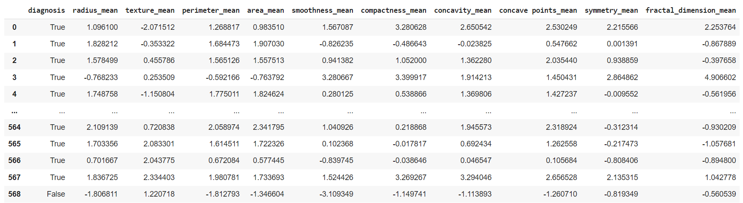

Slide 19
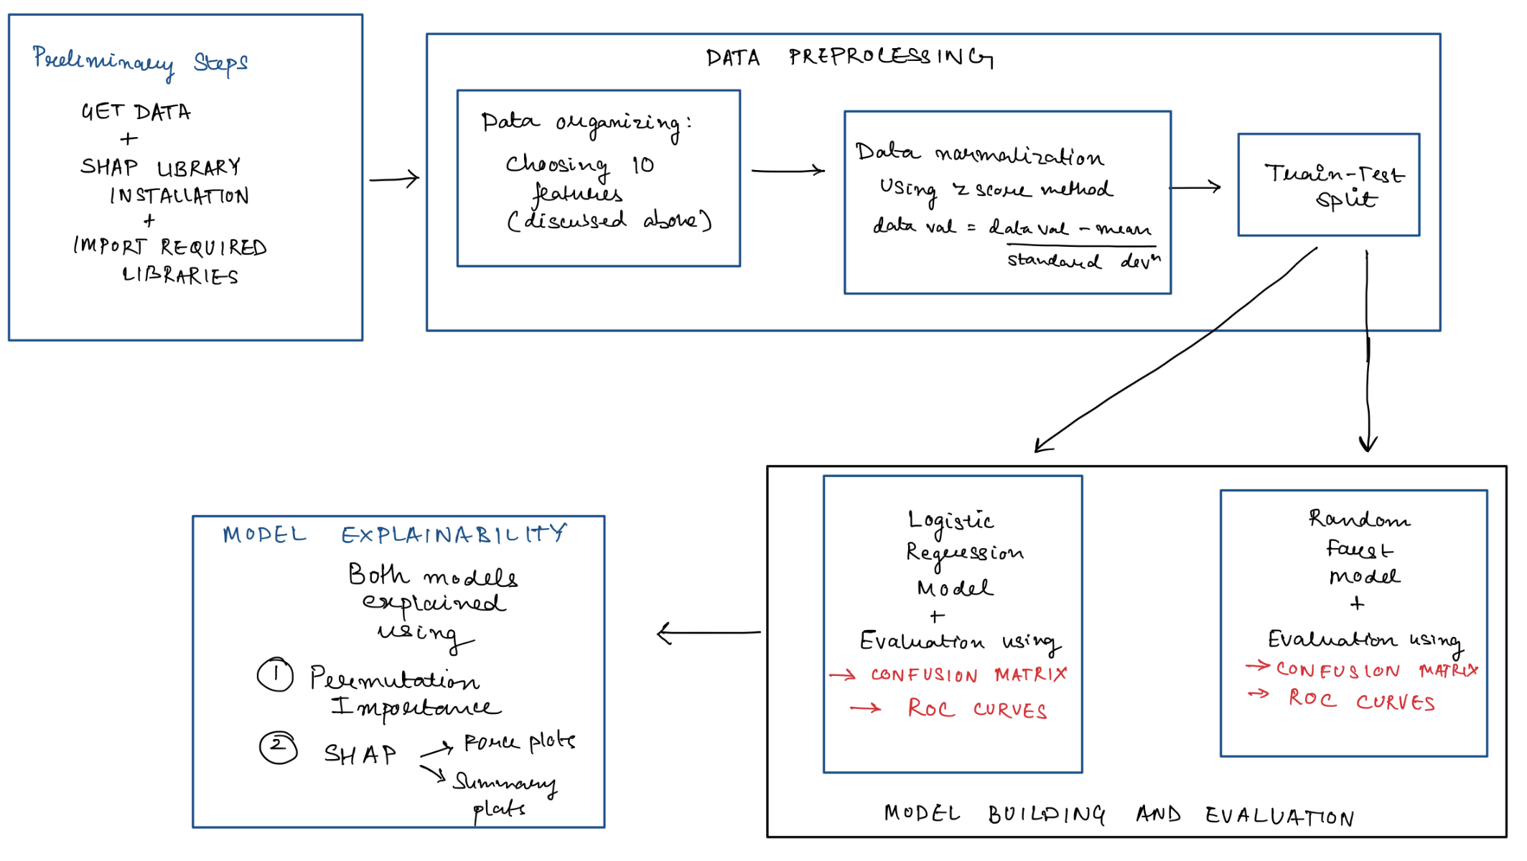
Project Workflow

Slide 20
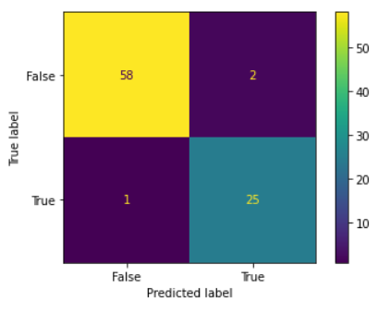
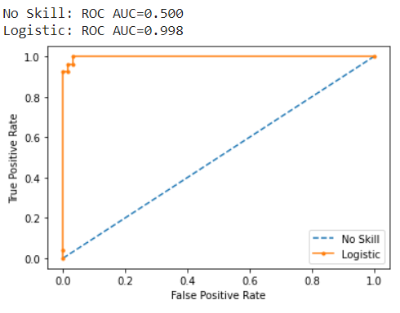
Model Results:
Logistic Regression
Accuracy = 96%
Confusion Matrix ROC Curve

Slide 21

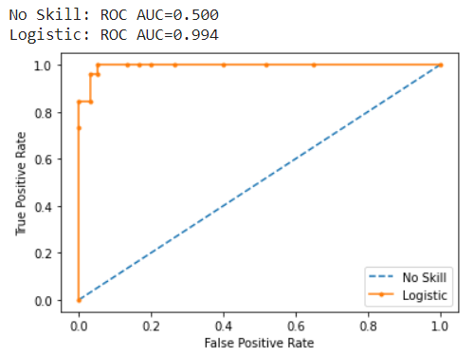
Model Results:
Random Forest
Accuracy = 95.3%
Confusion Matrix ROC Curve

Slide 22
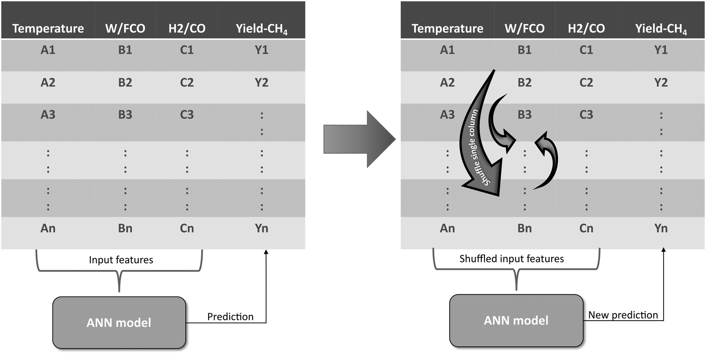
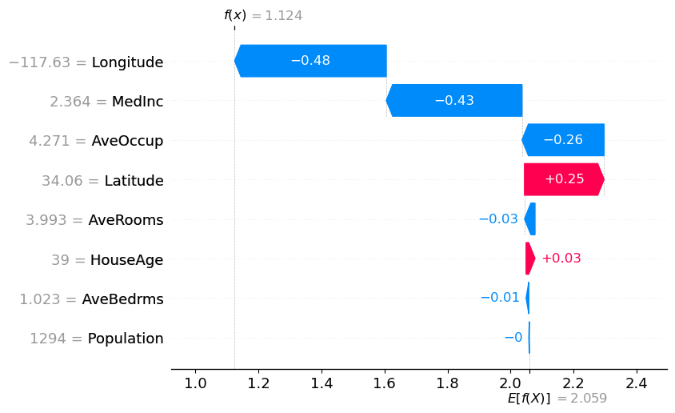
Model Explainability
Permutation Importance 2. SHAP Values

Slide 23
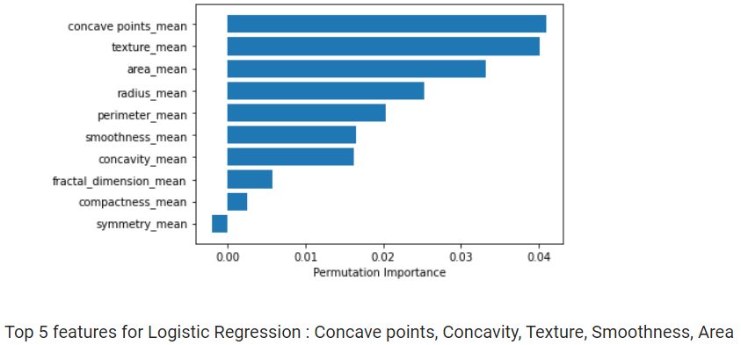
Permutation Importance:
Logistic Regression

Slide 24
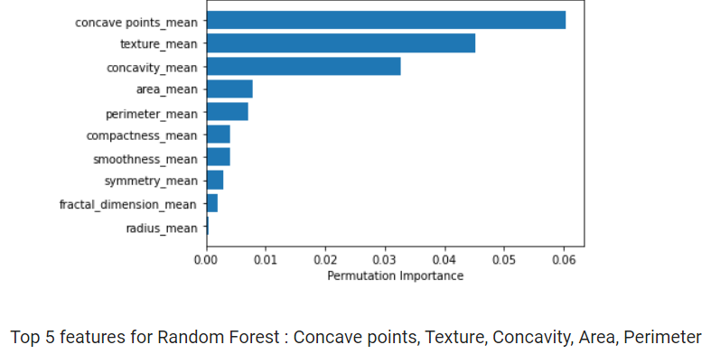
Permutation Importance:
Random Forest

Slide 25
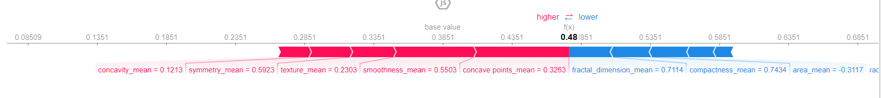
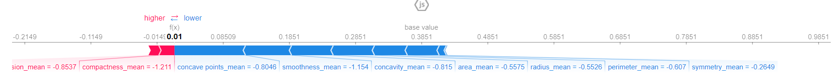
SHAP Force Plot:
Logistic Regression
Positive Instance
Negative Instance

Slide 26
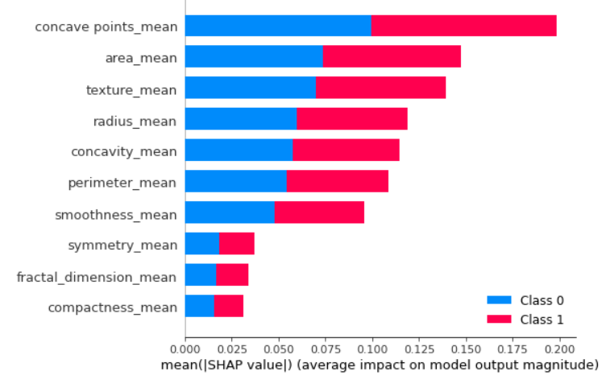
SHAP Summary Plot:
Logistic Regression

Slide 27
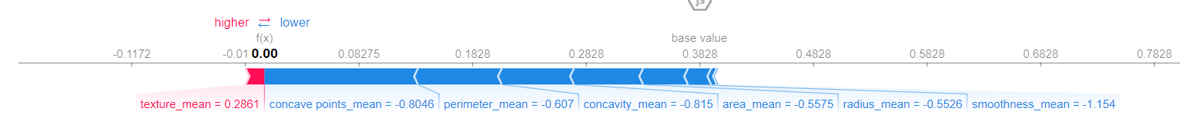
SHAP Force Plot:
Random Forest
Positive Instance
Negative Instance

Slide 28
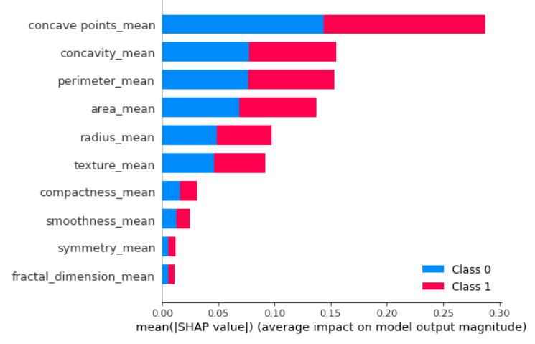
SHAP Summary Plot:
Random Forest

Slide 29
Conclusion

Slide 30
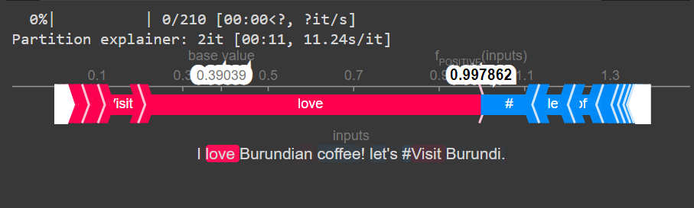
Other Applications of SHAP

Slide 31
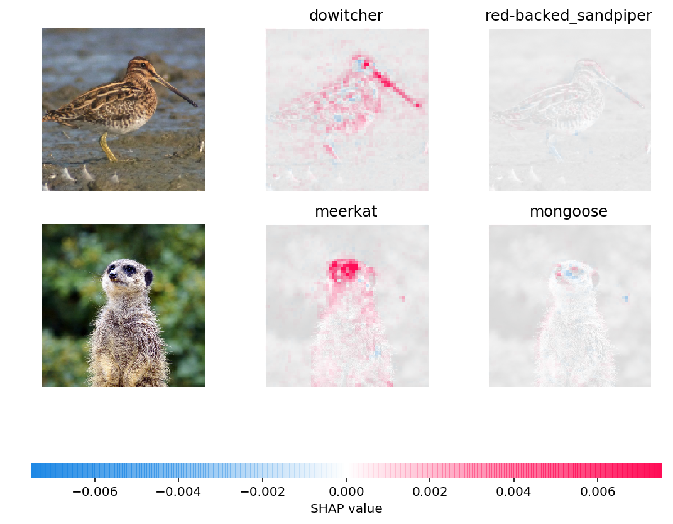

Slide 32
Limitations of SHAP
Computation Time
2. Interpretability
3. Axioms don’t hold under approximations

Slide 33
Future Research Directions
Hierarchy of coalition structure
Overlapping coalition structure
Solutions concept beyond Shapley value

Slide 34
Thank you!

